Slide 1
MODULE 1: INTRODUCTION TO THE HEA FRAMEWORK
Session 2. HEA Framework Introduction

Slide 2
HEA Framework Overview: Origins
HEA was developed in the early 1990s by Save the Children in order to improve the ability to predict short-term changes in access to food.

Slide 3
HEA Framework Overview: Origins
HEA’s inception was in response to a demand for an approach that could:
Quantify the problem
Allow for comparisons
Provide reliable results for large populations
Point to appropriate responses
Be predictive

Slide 4
HEA Framework Overview: Origins
Other agencies, such as F.E.G., FEWS NET, ACF and Oxfam, have since worked on the development of HEA, making it useful in a wide range of settings.

Slide 5
HEA Framework: Uses
An understanding of livelihoods is at the heart of HEA – leading to its application beyond emergency food needs
Disaster
Response
Rehabili-
tation
Early
Warning &
Scenario
Analysis
Development
Planning
Monitoring and
Evaluation

Slide 6
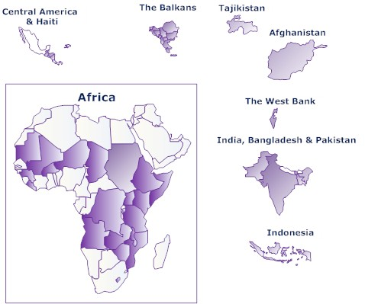
HEA Framework Overview: Uses
Where has HEA been used?

Slide 7
HEA Framework: Overview
HEA is an analytical framework
Notes:
Not so much a method of information gathering

Slide 8
HEA Framework: Overview
The HEA Analytical Framework
Defines the information that needs to be gathered
Specifies the way in which it should be analysed
Answers a particular set of questions linked to response

Slide 9
HEA Framework: Overview
The HEA Analytical Framework
Does not limit HOW field information is gathered
Can be implemented using a number of different field methods, including both HH questionnaires and RRA

Slide 10
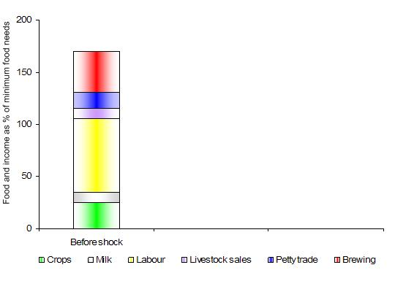
HEA Framework: Overview
HEA starts with an understanding of how households normally live….

Slide 11
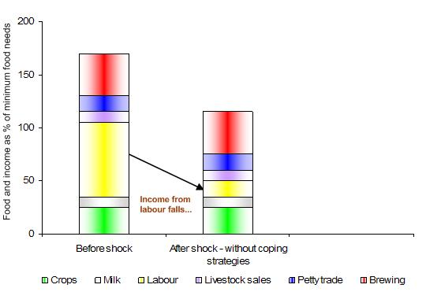
HEA Framework: Overview
…then it incorporates the impact of a shock….

Slide 12
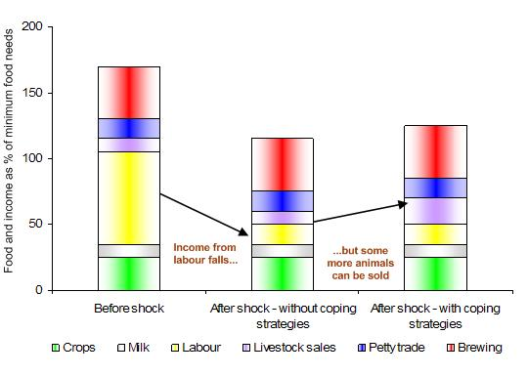
HEA Framework: Overview
The analysis suggests that post-shock, households will not be able to maintain their normal livelihood assets without assistance.
…and finally looks at how people might be able to cope.
Livelihoods Protection Threshold
Gap
Survival Threshold

Slide 13
HEA Framework Overview: Components
In sum….
BASELINE

Slide 14
HEA Framework Overview: Components
In sum….
BASELINE
+
HAZARD

Slide 15
HEA Framework Overview: Components
In sum….
+
+
BASELINE
HAZARD
COPING

Slide 16
HEA Framework Overview: Components
In sum….
+
+
=
BASELINE
HAZARD
COPING
OUTCOME

Slide 17
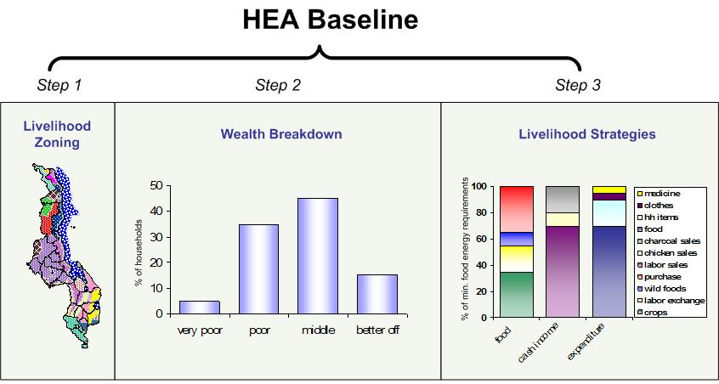
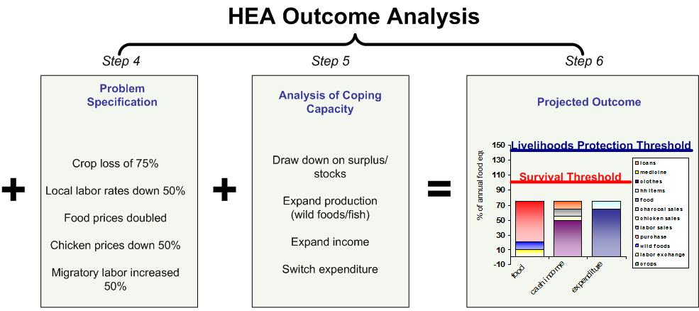
HEA Framework Overview: Components
In practice this process is broken into six steps
+
+
=
BASELINE
HAZARD
COPING
OUTCOME

Slide 18
HEA Framework Overview: Components
What it does:
Defines areas within which people share broadly the same patterns of livelihood
BASELINE
Step 1:
Why it is necessary:
Allows you to target geographically
&
to customize indicators for livelihoods monitoring systems

Slide 19
HEA Framework Overview: Components
What it does:
Groups people together using local definitions of wealth and quantifies their livelihood assets
BASELINE
Step 2:
Why it is necessary:
Allows you to disaggregate the population and indicate who (and how many) need assistance

Slide 20
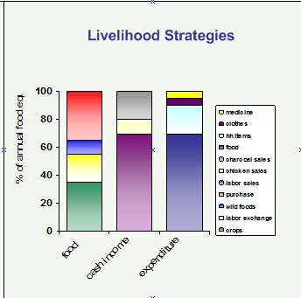
HEA Framework Overview: Components
What it does:
Quantifies sources of food and income, and expenditure patterns using ‘common currency’
BASELINE
Step 3:
Why it is necessary:
Enables comparisons across wealth groups, zones and countries
&
provides starting point for outcome analysis

Slide 21
HEA Framework Overview: Components
What it does:
Translates a hazard into economic consequences at household level
OUTCOME ANALYSIS
Step 4:
Why it is necessary:
Allows you to mathematically link the shock to each relevant livelihood strategy

Slide 22
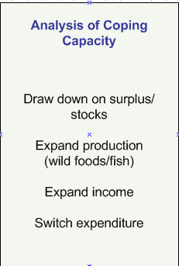
HEA Framework Overview: Components
What it does:
Assesses the ability of households to respond to the hazard
OUTCOME ANALYSIS
Step 5:
Why it is necessary:
Determines the amount of external assistance required
&
Highlights monitoring indicators for testing prediction

Slide 23
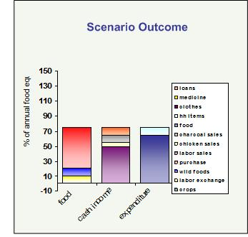
HEA Framework Overview: Components
What it does:
Predicts the outcome of the hazard in relation to livelihood protection and survival thresholds
OUTCOME ANALYSIS
Predicted Outcome
Step 6:
Livelihoods Protection Threshold
Why it is necessary:
Allows you to determine whether people need external assistance in order to survive and/or to maintain their livelihood assets
Survival Threshold

Slide 24
In sum, the HEA Framework
Allows for a systematic analysis of the predicted effects of a hazard or multiple hazards on household livelihood assets
Provides a system for comparing poverty levels and prioritising needs across areas
Can be re-used year after year, saving money
Highlights a range of appropriate responses (not just food)

